Slide 1
Juspay Namma Yatri Hackathon
Submitted by:
Nikhil Lamba( team leader)
Tushar Rathore(contributor)
Sadbhav Singh(contributor)

Slide 2
Namma Yatri
Problem Statement 2: Booking without app
Solution: Booking on phone.
Steps:
1.Call on a specific contact number of Namma Yatri.
2. Specify the following: “Book me a ride from ______ to _____”.
3. Your Gps location will be traced and in the database your current location in column “from” and destination in column “to” will be saved.
4. Nearest driver to that location will get an alert from the system, once he confirms the ride user will be informed with estimated time.

Slide 3
Solution’s architecture
Use of technology:
Twilio’s calling service via python code is utilized for the sake of proof of concept.
Openai’s Whisper model is used for voice to text conversion.
Traditional python programming for filtering the text for keywords like: “from” and “to” for storage of pick-up and destination place in database.
We are attaching codes and files for the sake of POC(proof of concept).

Slide 4
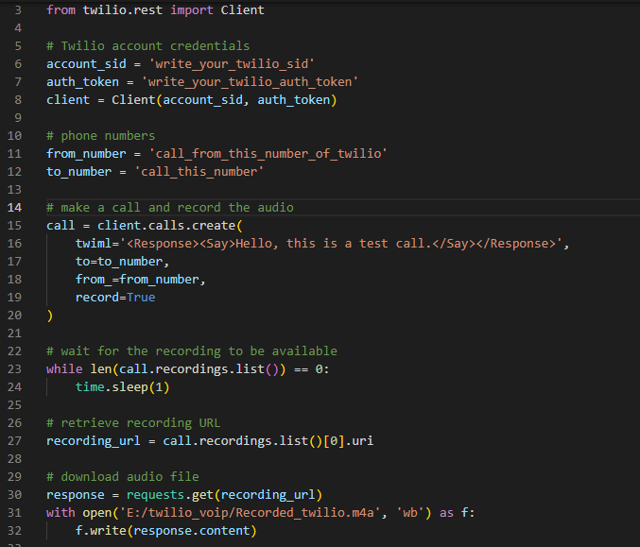
Write your sid and authentication token from twilio account.
Write the contact number to be called from your twilio contact number.
Save the voice of your customer without breaking the privacy, and process further just to extract starting location and destination, i.e., “from” and “to”.

Slide 5
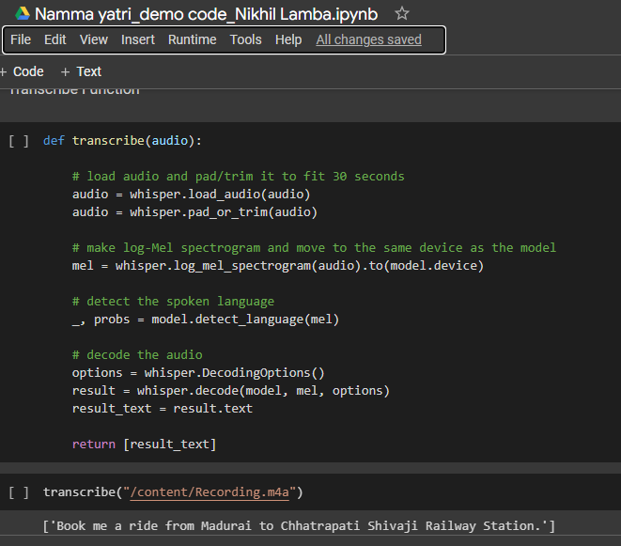
transcribe function: for converting audio to text via use of Whisper ( Openai’s model).
Processing recorded file of twilio call.
Output of transcribe function

Slide 6
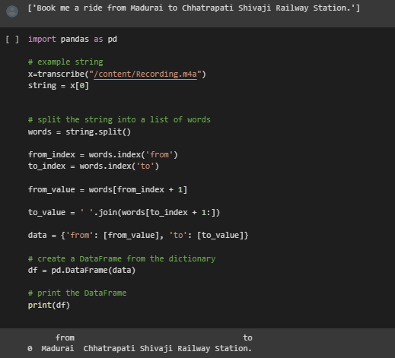
Traditional python code for processing “from”-> source
“to” ->destination and storing in a database.
Output of dataframe to be saved in a database for system processing and notification purpose.

Slide 7
Namma Yatri
Problem Statement 3: Customer Acquisition
Solution: Game Theory application and analysis via octalysis(management concept)
Steps:
Showing how much will the customers get after sticking to the reliable platform of Namma Yatri.
Providing points to each customer by increasing with a certain amount each weekend.
With liquifying those points customers will have the option of couple of watch hours on OTT platforms and even high chances at the time of FIFA, IPL, ISL,etc. On platforms like: Jio Cinema, Hotstar, Amazon Prime, Netflix, etc.

Slide 8
4. By doing so, one can retain the customers on Namma Yatri platform.
5. Partnership with social media platforms like: WhatsApp,Snapchat,telegram,etc.
Making the slogans and reels viral like:
Why to fear,
Namma Yatri is here.
Just say on call “from” and “to”,
and rest Namma Yatri will do.

Slide 9
Thank you
Please reach out to us on (lamba.nikhil24@gmail.com), if any confusion in code or presentation.
Will be really glad to hear back.

